Slide 1


Presentation
Semantic Keyword
Extraction and
Corpus Indexing
Framework
Team : 5
Member 1 : T Ashish Reddy (2510080030)
Member 2: Sai Hemesh Reddy(2510080003)
Member 3: Dhanush Reddy(2510080018)
Member 4: Karthik Bhardwaj(2510080042)

Slide 2


Problem Statement
Organizations store vast volumes of documents, making quick and accurate information retrieval increasingly difficult. As document repositories grow, locating the right information becomes a major bottleneck for productivity and decision-making.
Existing search systems return too many irrelevant results, requiring extensive manual review and analysis. Searching through and understanding large document collections is time-consuming and inefficient, creating significant pain points for users who need fast, precise answers.

Slide 3

Objectives
Store and manage large document collections effectively; automatically extract important keywords and build an efficient searchable index to enable fast, accurate document retrieval.
Retrieve the most relevant documents per user query with highlighted matching keywords and phrases; group similar documents for easier exploration and navigation.
Provide document analytics including frequently occurring keywords, related topics, and categories; significantly reduce time and effort required for searching and analyzing large document repositories.

Slide 4
Technology Stack
Primary Stack
• Language: Java
• Framework: Spring Boot
• Database: PostgreSQL
• Search Engine: Apache Lucene
• Algorithms: KMP, Rabin-Karp, Z-Algorithm, Suffix Array, LCP Array
• Frontend: HTML, CSS, JavaScript
• Version Control: Git & GitHub
Alternative Stack
• Frontend: React.js
• Backend: FastAPI (Python)
• Database: PostgreSQL
• Search Engine: Elasticsearch
• NLP: spaCy
• Charts: Chart.js
• Both stacks support the project's functional and performance requirements

Slide 5
Expected Outcomes
Fully functional document search platform developed, enabling users to upload, store, index, and search large document repositories with ease and reliability.
Quick and accurate document search capabilities with reduced search times compared to existing systems, minimizing manual review and analysis effort.
Well-organized and efficiently indexed document repository with keyword highlighting, document grouping, and analytics for improved information retrieval.

Slide 6

Project Modules
Document Indexing: Automatically extracts important keywords from uploaded documents and builds a structured, searchable index. Uses advanced algorithms including KMP, Rabin-Karp, and Suffix Arrays to ensure fast and accurate indexing of large document repositories.
1.
Search & Retrieval: Enables keyword-based document search and displays the most relevant results per user query. Highlights matching keywords and phrases within documents, significantly reducing the time and effort required to locate critical information.
2.

Slide 7



Project Plan
Phase 1: Requirements Gathering & Analysis
Identify functional and non-functional requirements, analyze user needs, define system scope, and document technical specifications for the Document Search and Retrieval System.
Phase 2: System & Database Design
Design the overall system architecture, define database schema using PostgreSQL, plan the indexing structure with Apache Lucene, and create UI/UX wireframes for the platform.

Slide 8



Project Plan (Phase 4–6)
Phase 4: Implementation of Indexing & Search Algorithms
Develop and integrate core search algorithms including KMP, Rabin-Karp, Z-Algorithm, Suffix Array, and LCP Array. Build the document indexing engine using Apache Lucene for fast and accurate keyword-based retrieval.
Phase 5: Frontend & Backend Integration
Connect the Spring Boot backend with the HTML/CSS/JavaScript frontend. Implement search UI, results display with keyword highlighting, and analytics dashboard. Phase 6: Testing, Debugging & Deployment
Conduct unit, integration, and performance testing. Resolve bugs and optimize system performance. Deploy the fully functional Document Search and Retrieval System.

Slide 9
Conclusion
The Document Search and Retrieval System aims to address the growing challenge of efficiently locating and analyzing information within large document repositories. By leveraging a robust technology stack — including Java, Spring Boot, Apache Lucene, and advanced string-matching algorithms such as KMP, Rabin-Karp, and Z-Algorithm — the system will deliver fast, accurate, and relevant search results.
Key outcomes include automated keyword extraction, efficient document indexing, intelligent clustering, and an analytics dashboard to surface insights. The platform will significantly reduce search time and manual effort for users.
Next Steps: Complete development phases, integrate frontend and backend components, conduct thorough testing, and deploy the fully functional platform by August 2026.

Slide 10
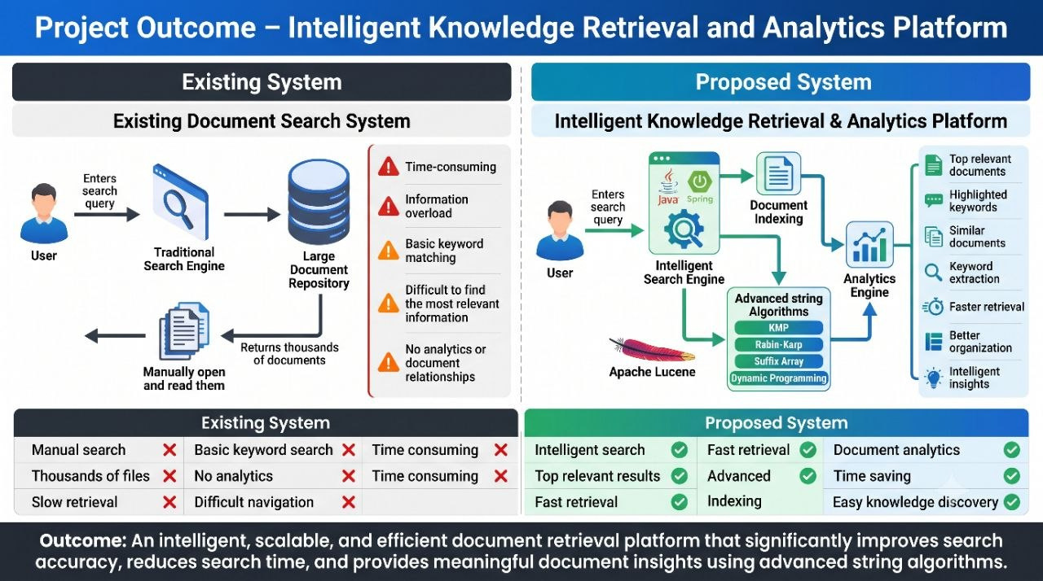

Slide 11
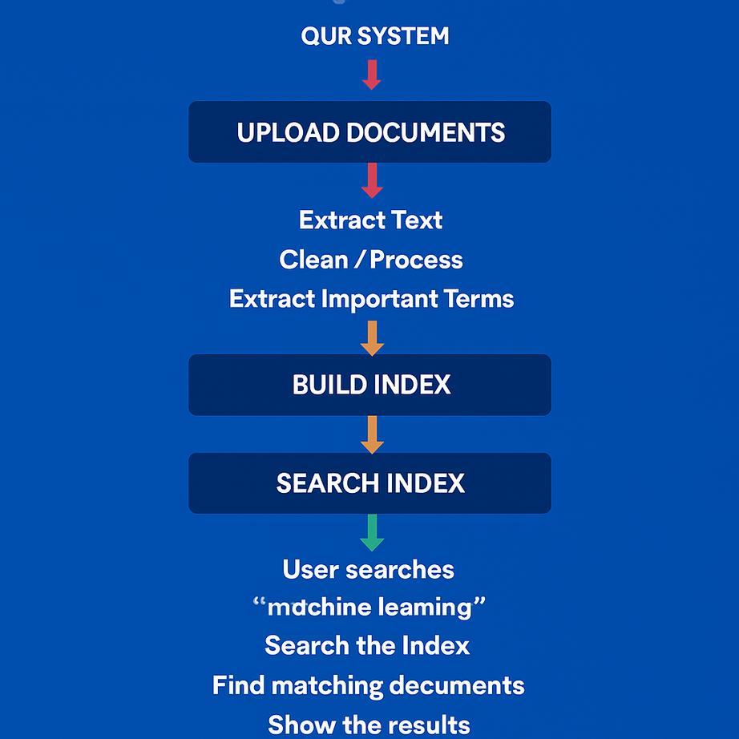
WORK FLOW

Slide 12



Thank You
| Document Search and Retrieval System Team

